Slide 1
Message Authentication Using symmetric key cryptography

Slide 2
Presented By:- Ashutosh Bandyopadhyay
Stream:- Computer Science And Engineering
Sec:- B
Roll:- 16800116086
Subject:- Message Authentication Using Symmetric Key Cryptography

Slide 3
Message Authentication
Why is Message Authentication?
protecting the integrity of a message
validating identity of originator
non-repudiation of origin (dispute resolution)
Message Authentication Functions
Hash Function
Message Encryption
Message Authentication Code (MAC)

Slide 4
Message Security Requirements
disclosure
traffic analysis
masquerade
content modification
sequence modification
timing modification
source repudiation
destination repudiation

Slide 5
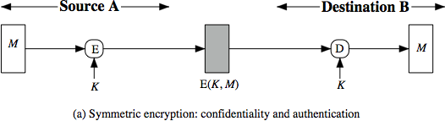
Symmetric Message Encryption
It provide Authentication, Confidentiality
If symmetric encryption is used then receiver knows that sender
must have created it since only sender and receiver now key used
Content cannot be altered
If message has suitable structure, redundancy or a checksum to detect any changes

Slide 6
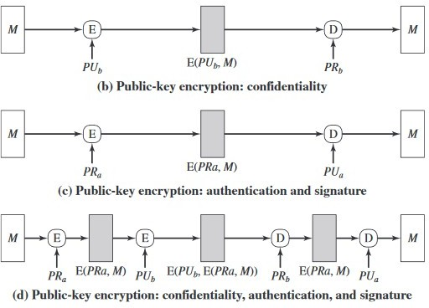
Public-Key Message Encryption

Slide 7
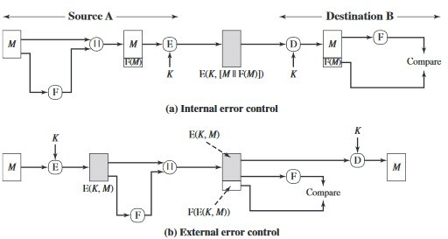
Internal/External Error Control

Slide 8
Message Authentication Code (MAC)
MAC is a small fixed-length code generated using key (K) and message(M).
MAC = C(K,M)
The code generated is not reversible.
MAC is appended to message as a signature.
At the receiver side a new MAC is calculated which is supposed to match with the original MAC.
MAC provides assurance that message is unaltered and comes from sender.
Unlike Hash function, There may be more than one plain text
which can generate the same MAC.

Slide 9
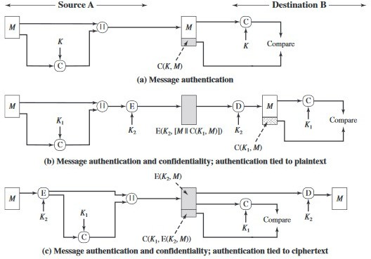
Message Authentication Code (MAC)

Slide 10
Thank You

Slide 11
Thank You

